Slide 1
Market Research with Accessibility in Mind
Accessibility Community Meeting (04/19/2022)
Angela Watkins, Section 508 Program Manager

Slide 2
Accessibility is Everyone’s Responsibility
Notes:
PBGC, Pension Benefit Guaranty Corporation is a small agency. So we work to educate and inform employees that Accessibility is Everyone’s Responsibility.

Slide 3
PBGC: Section 508 Monthly Events
Using the GSA Playbook as a guide, we established several (sustainable) monthly events
Section 508 is Great Debate – Q&A Sessions
2nd Tuesday of the Month 11-12 AM – via MS Teams
PBGC TechU – Where Tech Meets Usability – Hands-on Training
4th Wednesday – Via Learning & Development Registration
Current format – 1 Topic per quarter; 4 topics per year
Tie the Q&A Session to the Hands-on Training

Slide 4
PBGC: Section 508 Resources
PBGC Section 508 Library
Q&A Take-A-Ways
Training: PBGC Learning Series/PBGC Tech Exercises
Brochures
Other Resources
Checklists, Mission Accessible(s), 508 Overview Video
PBGC Monthly Tips
Sent via email (3rd Thursdays of the Month)
Saved to Library for Reference

Slide 5
Market Research Q&A Points
Notes:
During this presentation we’re going to get right into demonstrating the use of the Accessibility Checker for Microsoft products such as Word, Excel, and PowerPoint.
This demonstration is focused on the use of Microsoft Word and the Accessibility Checker.

Slide 6

Effective Market Research demonstrates three things
That it’s
Effective: Ability to answer questions from various stakeholders (effective)
Informative: Knowing how to document what was done
Productive: Knowing how to do market research to accomplish the first two items (productive)

Slide 7
Effective Market Research Answers Questions
• Business (background, the need, the goals and objectives)
• Security (FIPS, NIST, FedRAMP, Supply Chain, Risks)
• Privacy (Data access types, needs, duration)
• Infrastructure (What does it need to work, e.g., servers, virtual machines)
• Engineering (How does it need to work)
• Acquisition (Competitive Solutions, Cost, Quality of Performance)
• Enterprise (What's the impact on all our Stakeholders and how do we best use the capabilities of our portfolio and its cycle)
• Accessibility (Conformance: Yes/No; How do we help the user)

Slide 8
Market Research with Accessibility in Mind PBGC TechU: Exercises
Notes:
Get the help you need – Need the help you get
I’ll learn to speak your language, so it makes sense to you
Let me show you why you need to learn how to do this yourself
Sign in here, so I can prove that I spoke to you about this
Of the 3 “-pathys” only one leads to change - Empathy

Slide 9
Exercise #1: Using Google to Search
Notes:
Give a person a fish, they eat for a day. Teach a person to fish, they eat for a lifetime.
I like to teach people to fish.

Slide 10
Exercise 1: Using Google to Search
Use steps (Quick Tip) to find a quick comparison of a product
In the search area type: “Products like” [insert name of any preferred product/service].
Find sites that perform comparisons: (e.g., Siteimprove Alternatives & Competitors | G2)
Example Used: Siteimprove
Notes:
The GSA website was a life saver. Customizable
The Playbook –
Accessibility Webinars
GSA Listserv
GSA bi-monthly meetings
.

Slide 11
Exercise #2: Using Google to confirm ACR
Notes:
Have a sign in sheet to prove who’ve you talked to
Keep track so you can show your impact to your managers and others
All the presentations, meetings, trainings.

Slide 12
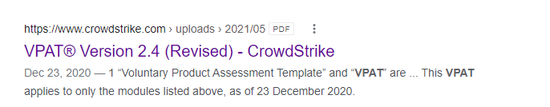
Exercise 2: Using Google to find VPAT/ACR Reports
Use a google search result to find a vendor’s reference to their Accessibility Conformance Report or use of the Voluntary Product Accessibility Template (VPAT) to create it.
Run a Google search; In the search area type in your keywords: e.g., CrowdStrike, VPAT
Example Used: CrowdStrike
Notes:
The GSA website was a life saver. Customizable
The Playbook –
Accessibility Webinars
GSA Listserv
GSA bi-monthly meetings
.

Slide 13
Exercise #3: Vendor’s Website to confirm proof of Accessibility
Notes:
Have a sign in sheet to prove who’ve you talked to
Keep track so you can show your impact to your managers and others
All the presentations, meetings, trainings.

Slide 14
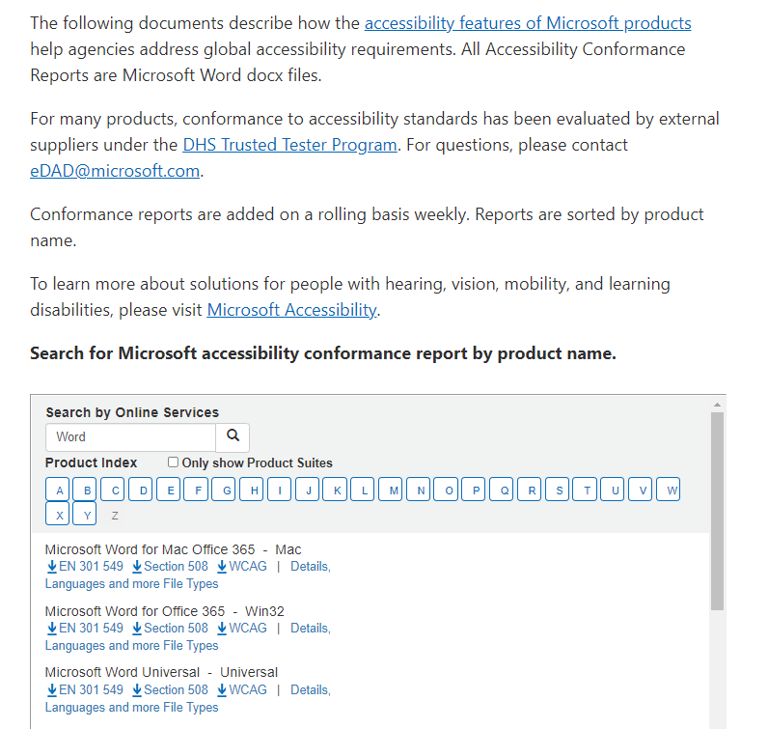
Exercise 3: Using a Vendor’s Site to Search
A Vendors website search using the following keywords (as examples): accessibility, VPAT, Accessibility Conformance Report
Example used: Microsoft
Site reference: Microsoft Accessibility Conformance Reports
Notes:
The GSA website was a life saver. Customizable
The Playbook –
Accessibility Webinars
GSA Listserv
GSA bi-monthly meetings
.

Slide 15
Exercise #4a: Contacting a Vendor directly (website)
Notes:
Have a sign in sheet to prove who’ve you talked to
Keep track so you can show your impact to your managers and others
All the presentations, meetings, trainings.

Slide 16
Exercise 4a: Use Vendor Site to Get Compliance Information
There are instances that a vendor has compliance information not immediately available on their website and they manually email it after inquiries are made.
The vendor contacted directly by email or phone from options available form their website: contact us, sales, and/or tech support inquiring about their evidence of Section 508 compliance and their response confirms they have evidence to provide regarding their adherence to section 508 and accessibility
Example: Dell
Site Reference: to Dell’s Voluntary Product Accessibility Template (VPAT) page
Notes:
The GSA website was a life saver. Customizable
The Playbook –
Accessibility Webinars
GSA Listserv
GSA bi-monthly meetings
.

Slide 17
Exercise #4b: Contacting a Vendor directly (email)
Notes:
Have a sign in sheet to prove who’ve you talked to
Keep track so you can show your impact to your managers and others
All the presentations, meetings, trainings.

Slide 18
Exercise 4b: Email Vendor to Get Compliance Info
Prepare an email to send to Vendor of other options don’t get a response
Subject: Inquiry: Is [Insert Product/Service Name] Accessible for people with disabilities?
Body:
Hello,
I work for the federal government.
Do you have any information, such as a completed Voluntary Product Accessibility Template (VPAT) or Accessibility Conformance Report (ACR), that describes how your product, [Product Name] (version ##), is accessible for people with disabilities that you can email to me?
Thank you for your help.
Let me know if you have any questions about my inquiry.
Notes:
The GSA website was a life saver. Customizable
The Playbook –
Accessibility Webinars
GSA Listserv
GSA bi-monthly meetings
.

Slide 19
Exercise #5: Accessibility Requirements Evaluation
Notes:
Have a sign in sheet to prove who’ve you talked to
Keep track so you can show your impact to your managers and others
All the presentations, meetings, trainings.

Slide 20
Exercise 5: Accessibility Requirements Evaluation
Learn where to find the Accessibility Requirements to help with vendor evaluation criteria and expectations of specific types of Information Communication Technology (ICT).
GSA’s Accessibility Requirements Tool
GSA’s Accessibility Requirements Tool (ART)­ can help with your market research, and thereby your procurement coordination, by providing education on the criteria required for an effective evaluation of products and the language you can use for your solicitation when submitting to the procurement department.
Notes:
The GSA website was a life saver. Customizable
The Playbook –
Accessibility Webinars
GSA Listserv
GSA bi-monthly meetings
.

Slide 21
Exercise #6: Determine if an exception is applicable
Notes:
Have a sign in sheet to prove who’ve you talked to
Keep track so you can show your impact to your managers and others
All the presentations, meetings, trainings.

Slide 22
Exercise 6: Determine if an exception is applicable
Understand what exceptions, as outlined the Section 508 law, may apply to various ICT.
The following exceptions may prove applicable – Select the following links to visit the Access-board:
Undue Burden or Fundamental Alteration (E202.6)
Best Meets (E202.7) previously referred to as Non-Availability
ICT Functions Located in Maintenance or Monitoring Spaces (E202.5)
Federal Contracts (E202.4)
Notes:
The GSA website was a life saver. Customizable
The Playbook –
Accessibility Webinars
GSA Listserv
GSA bi-monthly meetings
.

Slide 23
Contact Me
Angela R. Watkins, PMP, ITIL, CGEIT
Section 508 Program Manager
Accessibility is Everyone’s Responsibility
Pension Benefit Guaranty Corporation
Enterprise Governance Department
Office of Information Technology
E: watkins.angela@pbgc.gov
P: (202) 229-3181
C: 202.538.7548
My job is to— Share what I know with others, and
Learn from those who want to share with me (–arw)
Notes:
Please feel free to contact me if you would

Slide 24
Questions

